Slide 1

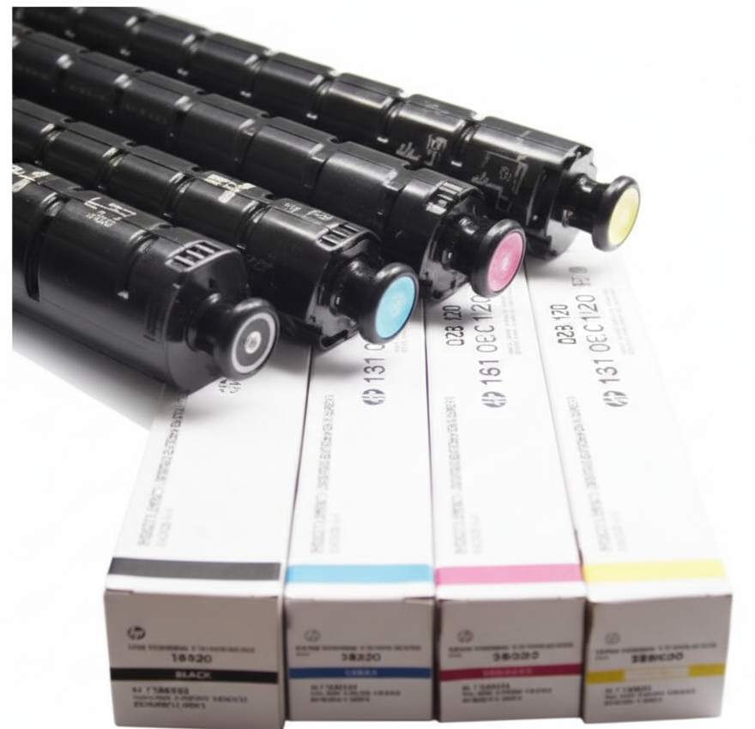
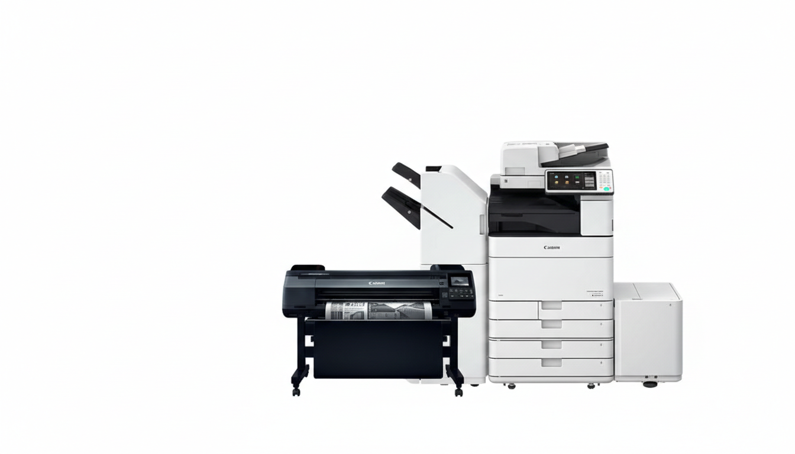
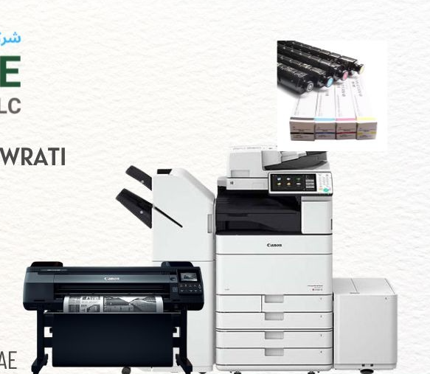
SIVARAMAIAH KOWRATI
Sales & Marketing
+971 56 486 4535
siva@printcareglobal.ae
MUWEILAH COMMERCIAL, SHARJAH, UAE
PRINTER | COPIER | PLOTTER | TONER | SALES | SERVICE | RENTAL | AMC

